Slide 1
How to write case

Slide 2
Definition
Scenario…
Tell us a story about why/what I want to check.
Given
I need make some preparation before testing
When
I need input or filter something during testing.
Then
I get the output and check them.

Slide 3
How to write
Step1
Create case under:
Add function test case to \beaver\tests\func
Add Unit test case to \beaver\tests\unit
Step 2
According your scenario to name your case
Step 3
Add code convention including scenario/Given/When/Then
Step 4
Add test code according case definition
Step 5
Checkout the related information about fail cases then we can update code or case base on them.

Slide 4
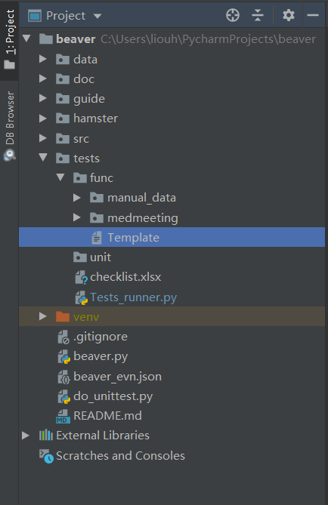
PATH

Slide 5
Template
#import # Create "case name.txt“ to store fail/pass number: #file = open("Case_name.txt", "w") #=====================================test case name======================================= #Scenario… #What do you want to check in this case? #Given… #The precondition of test case #When… #What do you give the input? #Then… #What do you want to get? #If you get what you wanna then pass_num+1 #If you don't get what you wanna then fail_num+1 # checkout file named by "case name" to store relate information about fail cases #===========================================checkout result====================================== #file.write("Fail:%s\n" % fail_num) #file.write("Pass:%s\n" % pass_num) #file.close()

